Slide 1

LUXURY AIRLINES TRENDS
VIP AIRPORT PICKUP & DROP-OFF
PRIVATE JET PARTNERSHIPS
FIRST-CLASS CHAUFFEUR TRANSFERS
LUXURY LOUNGE ACCESS
ELITE MILEAGE REWARDS
Offer luxury rental cars waiting at the airport gate for top-tier travelers.
Collaborate with private jet companies for seamless luxury travel.
Offer high-end car rentals as part of premium airline tickets.
Provide exclusive car rental perks to first-class & business-class flyers.
Allow frequent flyers to redeem miles for luxury car rentals.

Slide 2


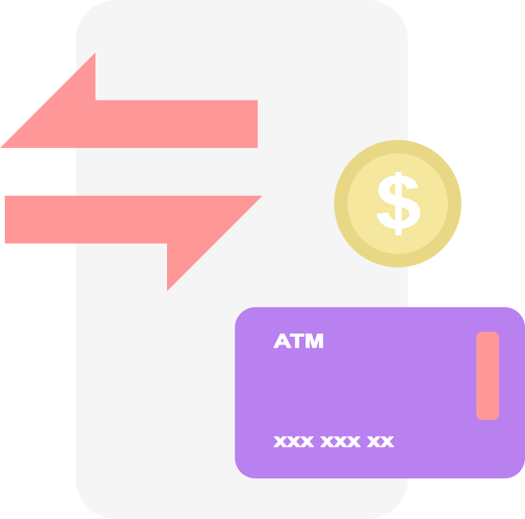

LUXURY CAR RENTALS & AIRLINES
Jet & Drive Packages
Exclusive Car Brands
Book a luxury car along with a first-class flight at a bundled rate.
Provide exotic brands (Bentley, Rolls-Royce, Aston Martin) as an upgrade for business travelers
In-Flight Car Concierge
Hotel & Airline Synergy
Let premium airline passengers pre-book their luxury car mid-flight.
Partner with 5-star hotels to offer seamless transport in a high-end car.
Luxury Experience Packages
Combine flights + luxury car rentals + VIP access to events (F1 races, golf resorts, fashion weeks).

Slide 3







STRATEGIES
01
Tailored Email Campaigns
Create personalized offers for frequent travelers based on their travel habits. Use segmentation to target high-net-worth individuals with luxury packages.
02
Social Media Influencer Partnerships
Collaborate with luxury lifestyle influencers who cater to affluent audiences. Document the seamless travel experience from private jet to luxury car in a series of Instagram stories or YouTube vlogs.
MARKETING
03
Exclusive Membership Programs
Offer a VIP program where members receive early access to promotions on private jets and high-end rentals. A loyalty points system could also encourage repeat business.
04
Place ads or featured content in high-end travel and lifestyle publications like Condé Nast Traveler, Robb Report, or The Financial Times. Focus on showcasing exclusive experiences, such as the "Jet & Drive" packages.
Luxury Lifestyle Magazines & Websites

Slide 4
STRATEGIES
01
Partner with elite private jet services like NetJets or VistaJet to offer bundled deals that include car rentals, exclusive airport lounges, and concierge services. You could cross-promote each other’s services in brochures and on digital platforms.
Private Jet Companies
02
Partner with luxury hotels such as the Four Seasons or Ritz-Carlton to offer bundled deals, where guests receive a luxury car rental along with their room booking, or even a VIP airport transfer directly to the hotel.
Luxury Hotel Chains
PARTNERSHIP
03
Connect with luxury event organizers like the Formula 1 or the Oscars to offer exclusive access to their events as part of the package. Customers could receive VIP tickets, private parking, and luxury transport.
VIP Event Partnerships
04
Develop partnerships with brands like Bentley, Rolls-Royce, or Aston Martin for limited-time car rental offers exclusively for premium passengers, and use these partnerships as marketing tools to attract high-end customers
Exotic Car Brands

Slide 5
STRATEGIES
01
Provide an app for customers to book their luxury car rentals, request chauffeur services, or even book hotel rooms mid-flight or during their trip. This could integrate with their flight details to give them a seamless luxury experience.
In-App Concierge
02
Create personalized experience packages based on customer preferences—allowing travelers to choose their flight, hotel, car, and exclusive events from one platform. VIP clients could have a dedicated concierge to assist with bespoke requests.
Tailored VIP Packages
CUSTOMER ENGAGEMENT
03
For frequent flyers, offer exclusive perks for hitting milestones, such as complimentary upgrades to Rolls-Royce for special occasions or access to ultra-exclusive events like private yacht parties or gala dinners.
Custom Milestone Rewards
04
Develop an elite loyalty program where frequent customers can redeem points or miles not only for flights but also for luxury car rentals, first-class experiences, or upgrades to private jet services.
Loyalty Programs

Slide 6














Private Jet Partnerships & Luxury Travel
First-Class Chauffeur Transfers & Luxury Lounge Access
VistaJet is a prominent private jet provider that partners with luxury hotels and offers a seamless travel experience for high-net-worth individuals. They offer bespoke services, including private flight bookings and luxury car rentals.
Known for offering premium services like chauffeur-driven transfers and access to exclusive airport lounges for business and first-class passengers.
NetJets, part of Berkshire Hathaway, offers fractional jet ownership and private jet services, allowing customers to book seamless flights and luxury transportation.
Offers exclusive limousine transfers and access to their luxurious first-class lounges for high-tier passengers

Slide 7





Elite Mileage Rewards & VIP Airport Pickup
Jet & Drive Packages & Exclusive Car Brands
High-end car rental companies like Sixt and Hertz have special deals with luxury car brands such as Aston Martin, offering exclusive options for business travelers and first-class customers
This service often works in conjunction with top airlines, offering elite members luxury perks like priority access, VIP transfers, and upgrades.
Lufthansa’s frequent flyer program allows customers to redeem miles for luxury upgrades, including car rentals, hotel stays, and more.
Partnering with luxury brands such as Bentley or Rolls-Royce, Marriott hotels within the Luxury Collection offer car rentals and seamless transport services for their top-tier guests

Slide 8


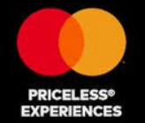

In-Flight Car Concierge & Hotel & Airline Synergy
Luxury Experience Packages & VIP Event Access
Collaborations between Four Seasons Hotels and private airlines provide exclusive travel packages where clients are picked up from the airport in luxury cars. Four Seasons also offers in-flight concierge services.
Official F1 luxury experiences offer high-net-worth individuals VIP access to races, including exclusive parking and luxury transport options.
MasterCard’s partnership with airlines and luxury brands offers exclusive VIP access to high-profile events like the Met Gala, Formula 1, and more.
This company combines private jet travel with car rentals to offer luxury transport from the airport to any destination, including hotels and events.

Slide 9


Luxury Car Rentals: Elite & Exotic Car Brands
Offers exclusive luxury and exotic cars for rentals, including brands like Bentley, Rolls-Royce, and Aston Martin.
Avis offers premium rental services for high-end cars like Rolls-Royce and Maserati, catering to business and first-class passengers.

